Slide 1




MAJOR PROJECT
(KCA)
Even Semester
Session 2024-25
MockMate(Your Interview buddy)
SHIVANI SAHU:-2300290140173
VINAYAK SAXENA:-2300290140202
SRISHTI BHATT:-2300290140178
Project Supervisor
Ms. Annu Yadav
(Assosciate Prof.)

Slide 2




Project Overview
02
Introducing our innovative AI Mock Interview platform—a cutting-edge solution designed to help candidates ace their job interviews. Leveraging advanced artificial intelligence, our platform conducts realistic mock interviews tailored to specific fields of expertise, including software engineering, marketing, finance, and more.
Candidates receive real-time feedback, comprehensive performance reviews, and detailed ratings based on predefined evaluation criteria. Our user-friendly interface ensures a seamless experience, while continuous learning algorithms keep the interview process up-to-date and relevant.

Slide 3



Problem Statement
Job candidates often struggle with interview preparation, leading to anxiety and suboptimal performance during actual interviews. Traditional mock interviews lack personalization and timely feedback, leaving candidates uncertain about their strengths and weaknesses. There is a need for an innovative solution that provides realistic, field-specific interview simulations, comprehensive performance evaluations, and actionable feedback to enhance interview readiness and confidence.
03

Slide 4





Objectives
ENHANCCED CANDIDATE PREPARATION
SKILL DEVELOPMENT OF CANDIDATES
EFFIFCIENT INTERVIEW PROCESS
CONTINOUS IMPROVEMENT
DATA DRIVEN INSIGHTS
08

Slide 5


Technologies Used
05
Hardware Requirements
CPU: High Performance Multi-Core Processor
RAM: Atleast 64GB and more
OS: Windows, MacOS, Linux
Internet Connection: High Speed internet Connection to avoid Latency
Backup and Storage: External Storage devices or Cloud storage for Backup.

Slide 6
Technologies Used
05
Software Requirements
Languages: HTML, CSS, JavaScript.
Frameworks: React, Next.js, Tailwind CSS, Drizzle ORM
Artificial Intelligence: Gemini AI
Authentication: Clerk
Database: MongoDBw

Slide 7

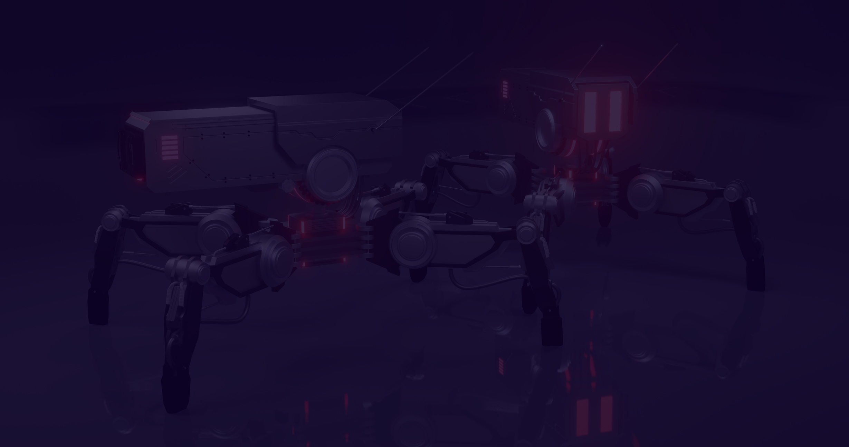

Modules
06
User Management Module
Interview Preparation Module
3. Interview Simulation Module
4. Evaluaation and Feedback
5. User Dashboard Module
6. Reporting and Analytics

Slide 8



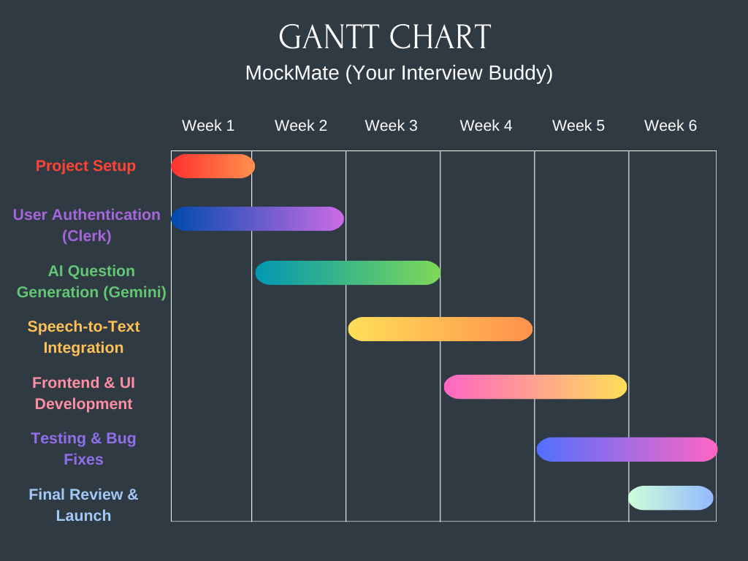
07
Gantt Chart

Slide 9





Thank You!
Get in touch with us
+91-9643037484
vinayak2002saxena@gmail.com

